Slide 1

Sexual Health Board Report
January 2024

Slide 2
Sexual Health
Key Messages
January 2024
HQ diagnoses ~13% of Gonorrhea, 4% of Chlamydia, and 13% of HIV in Ontario in the first 10 months of 2023 (Diseases of Public Health Significance Cases (publichealthontario.ca), pages 2-4)
Return patients are increasing; new patients numbers holding steady.
Increase in the absolute number of underinsured patients living with HIV that HQ is their primary HIV care provider
123456
1

Slide 3
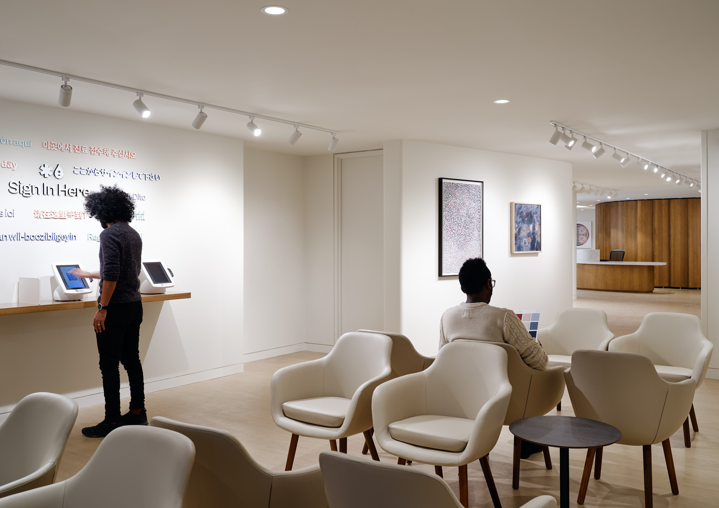

Cumulative data on sexual health visit from July 2022 to January 2024
33,278 visits
9470 individuals
2

Slide 4
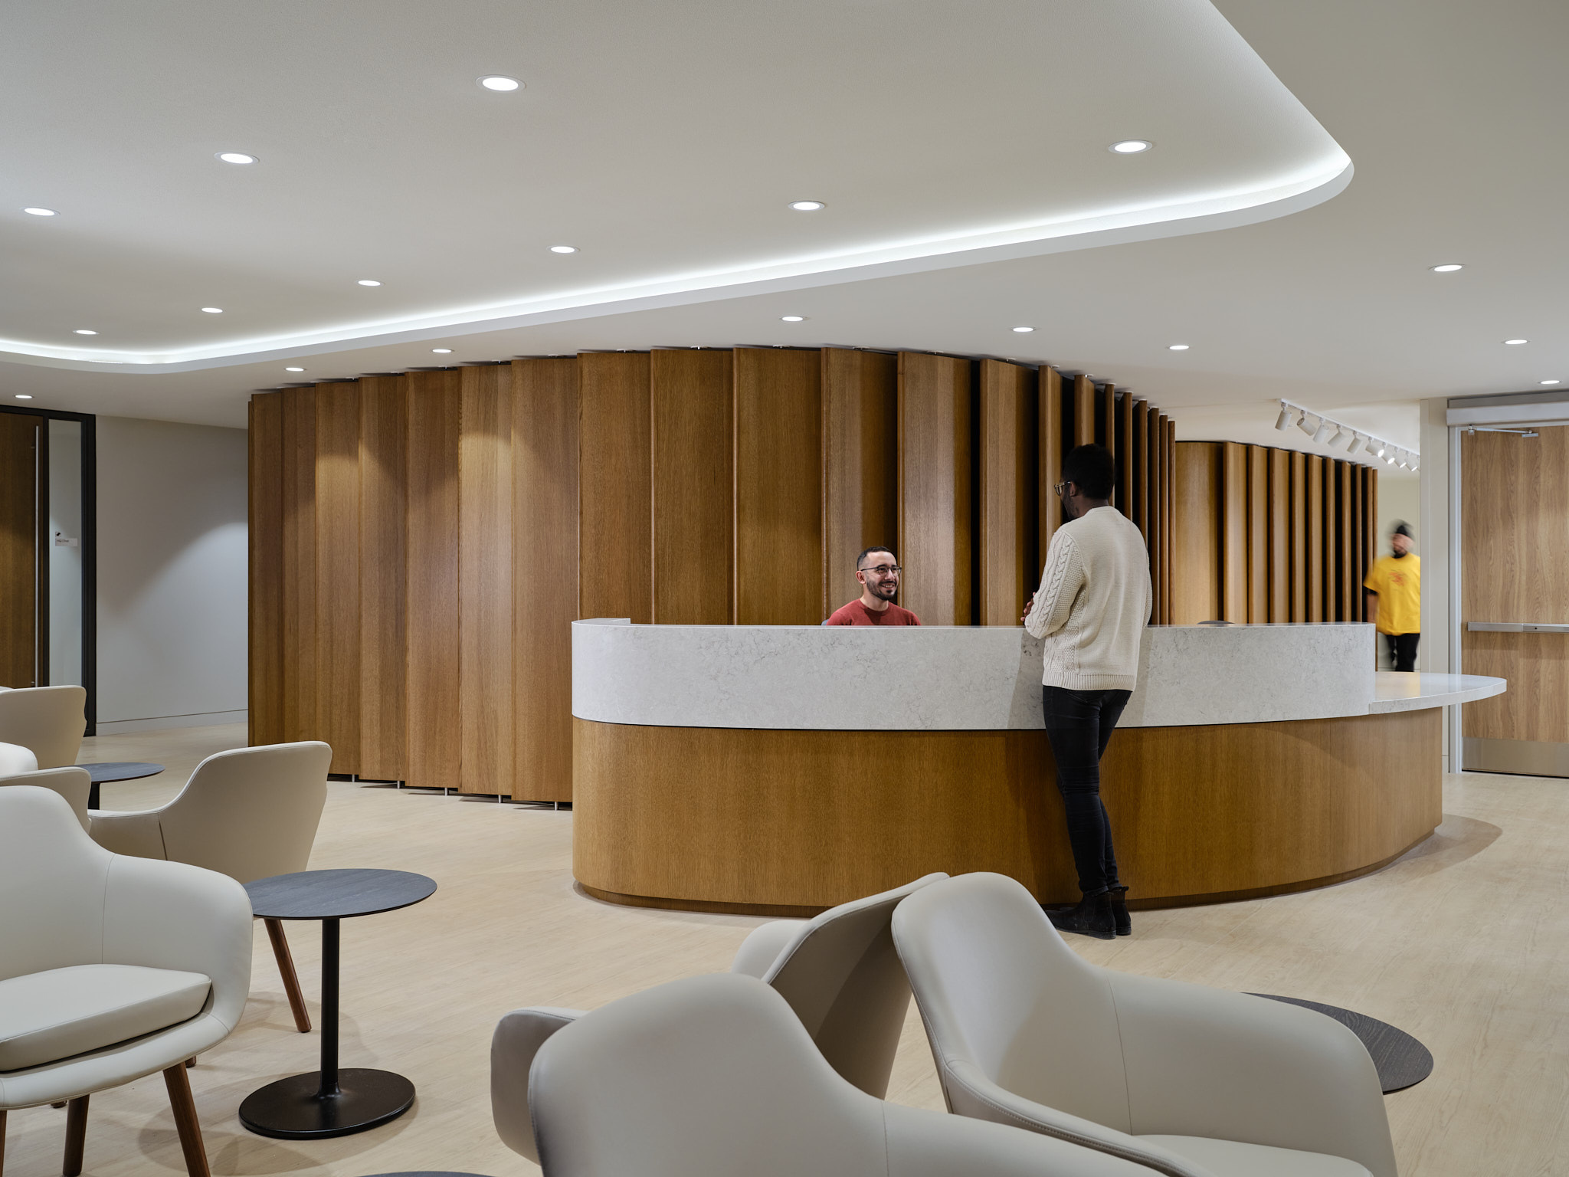
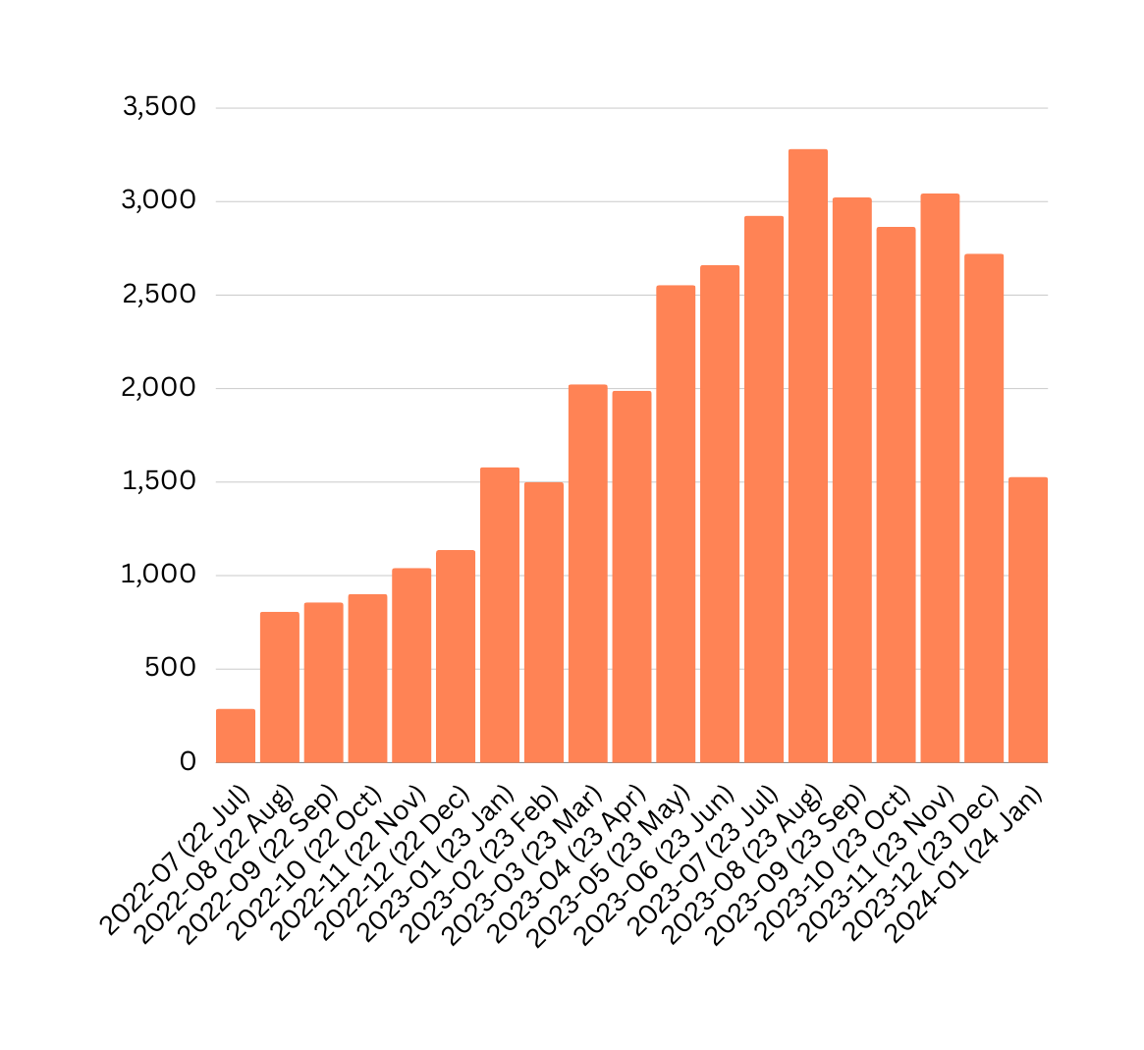
Total Visits to HQ
July 2022 to January 2024
4,725 visits in 2022
27,025 visits in 2023
1,528 visits in 2024
3

Slide 5





Demographics
July 2022 to January 2024
Average age of 34
10.5% living with HIV
Cis men: 88%
Trans men: 0.7%
Trans women: 1.2%
Non binary: 5.6%
Other gender identity : 1.5%
4

Slide 6
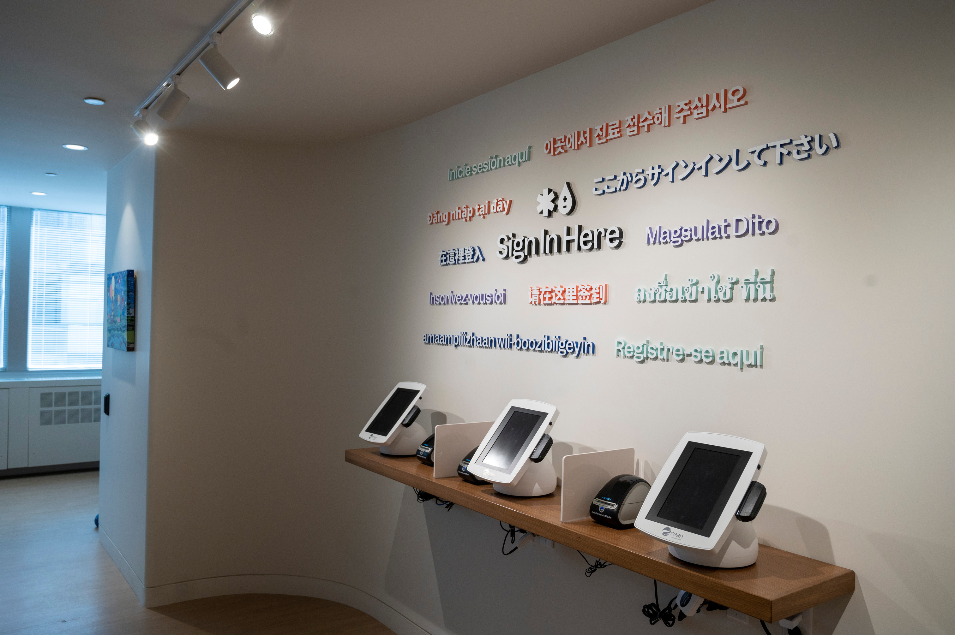
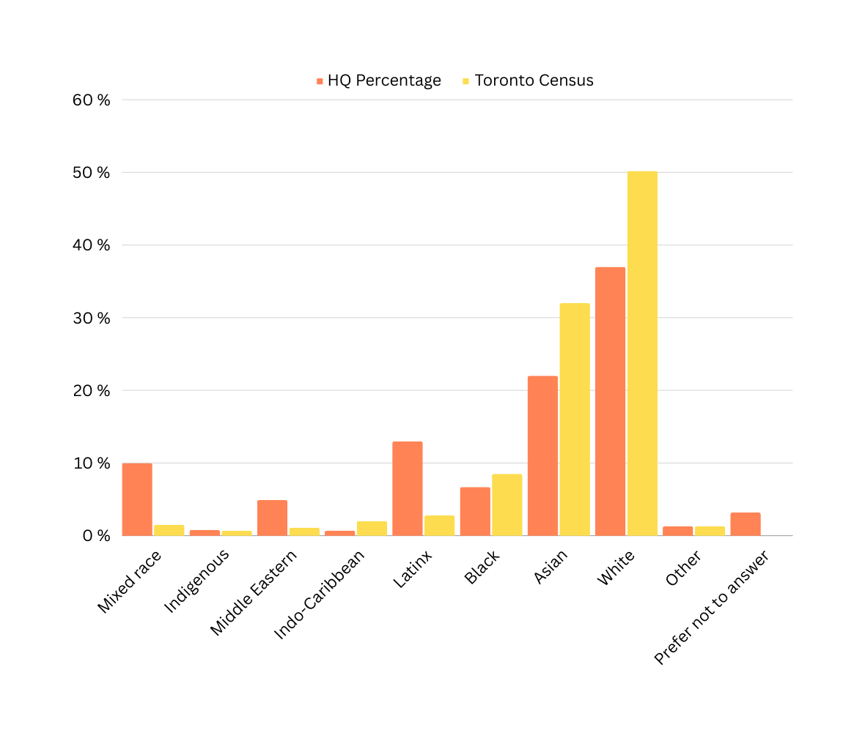
Ethnicity by individuals
July 2022 to January 2024
6

Slide 7
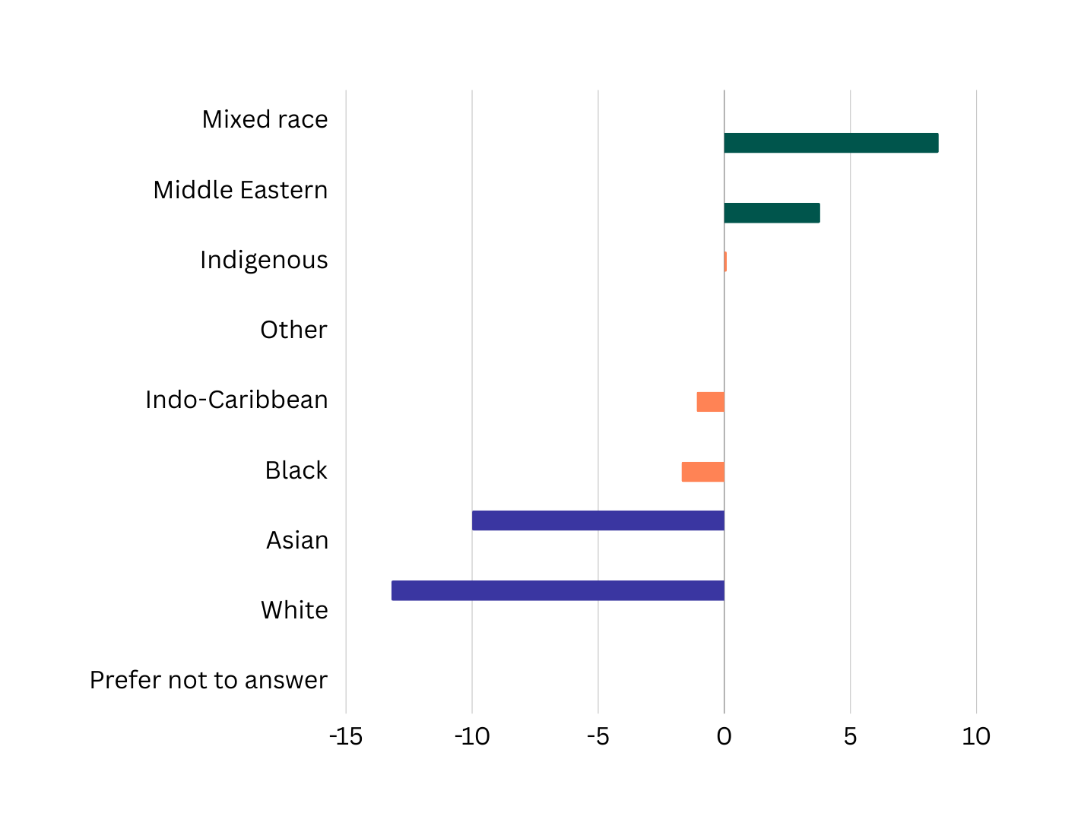
<Toronto Census
= Toronto Census
> Toronto Census
Ethinicity
(Difference between Toronto 2020 Census and HQ
7

Slide 8
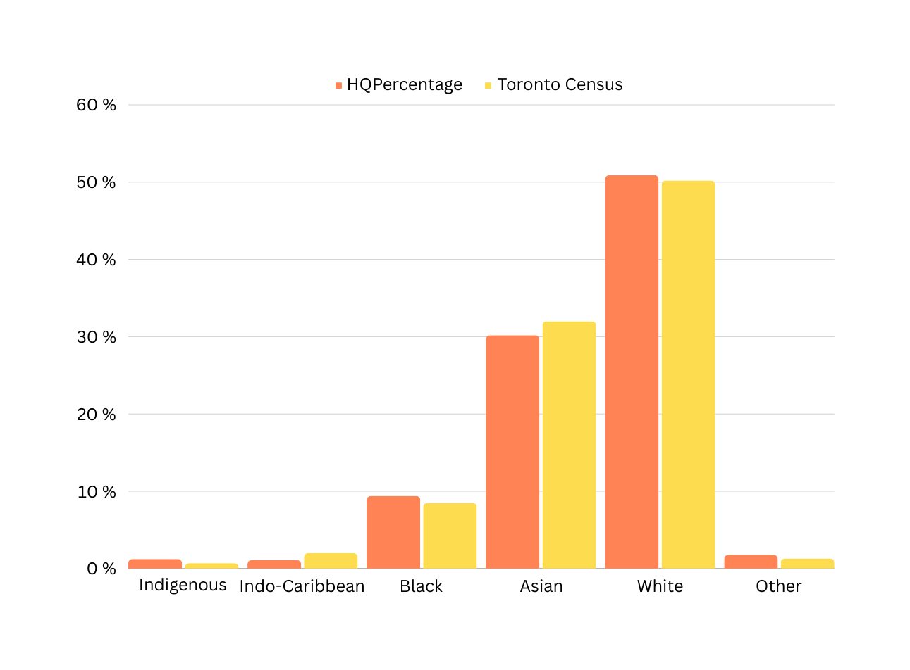
Ethnicity, by individual
Corrected for increases in Latinx, Mixed and Middle Eastern individuals by removing over-represented groups then re-calculating percentages
8

Slide 9

“The nurse was ... amazing.
Calmed me right down knew I was going through it and I couldn’t ask for better care”
- Anonymous survey regarding HIV Care
9

Slide 10
“Me siento muy afortunado de tener cerca a una clinica tan vanguardista como HQ”
- Anonymous survey 2
"I feel very fortunate to have a state-of-the-art clinic like HQ nearby."
“I was very happy with all the caring and attention. Great job guys”
- Anonymous survey 3
9

Slide 11
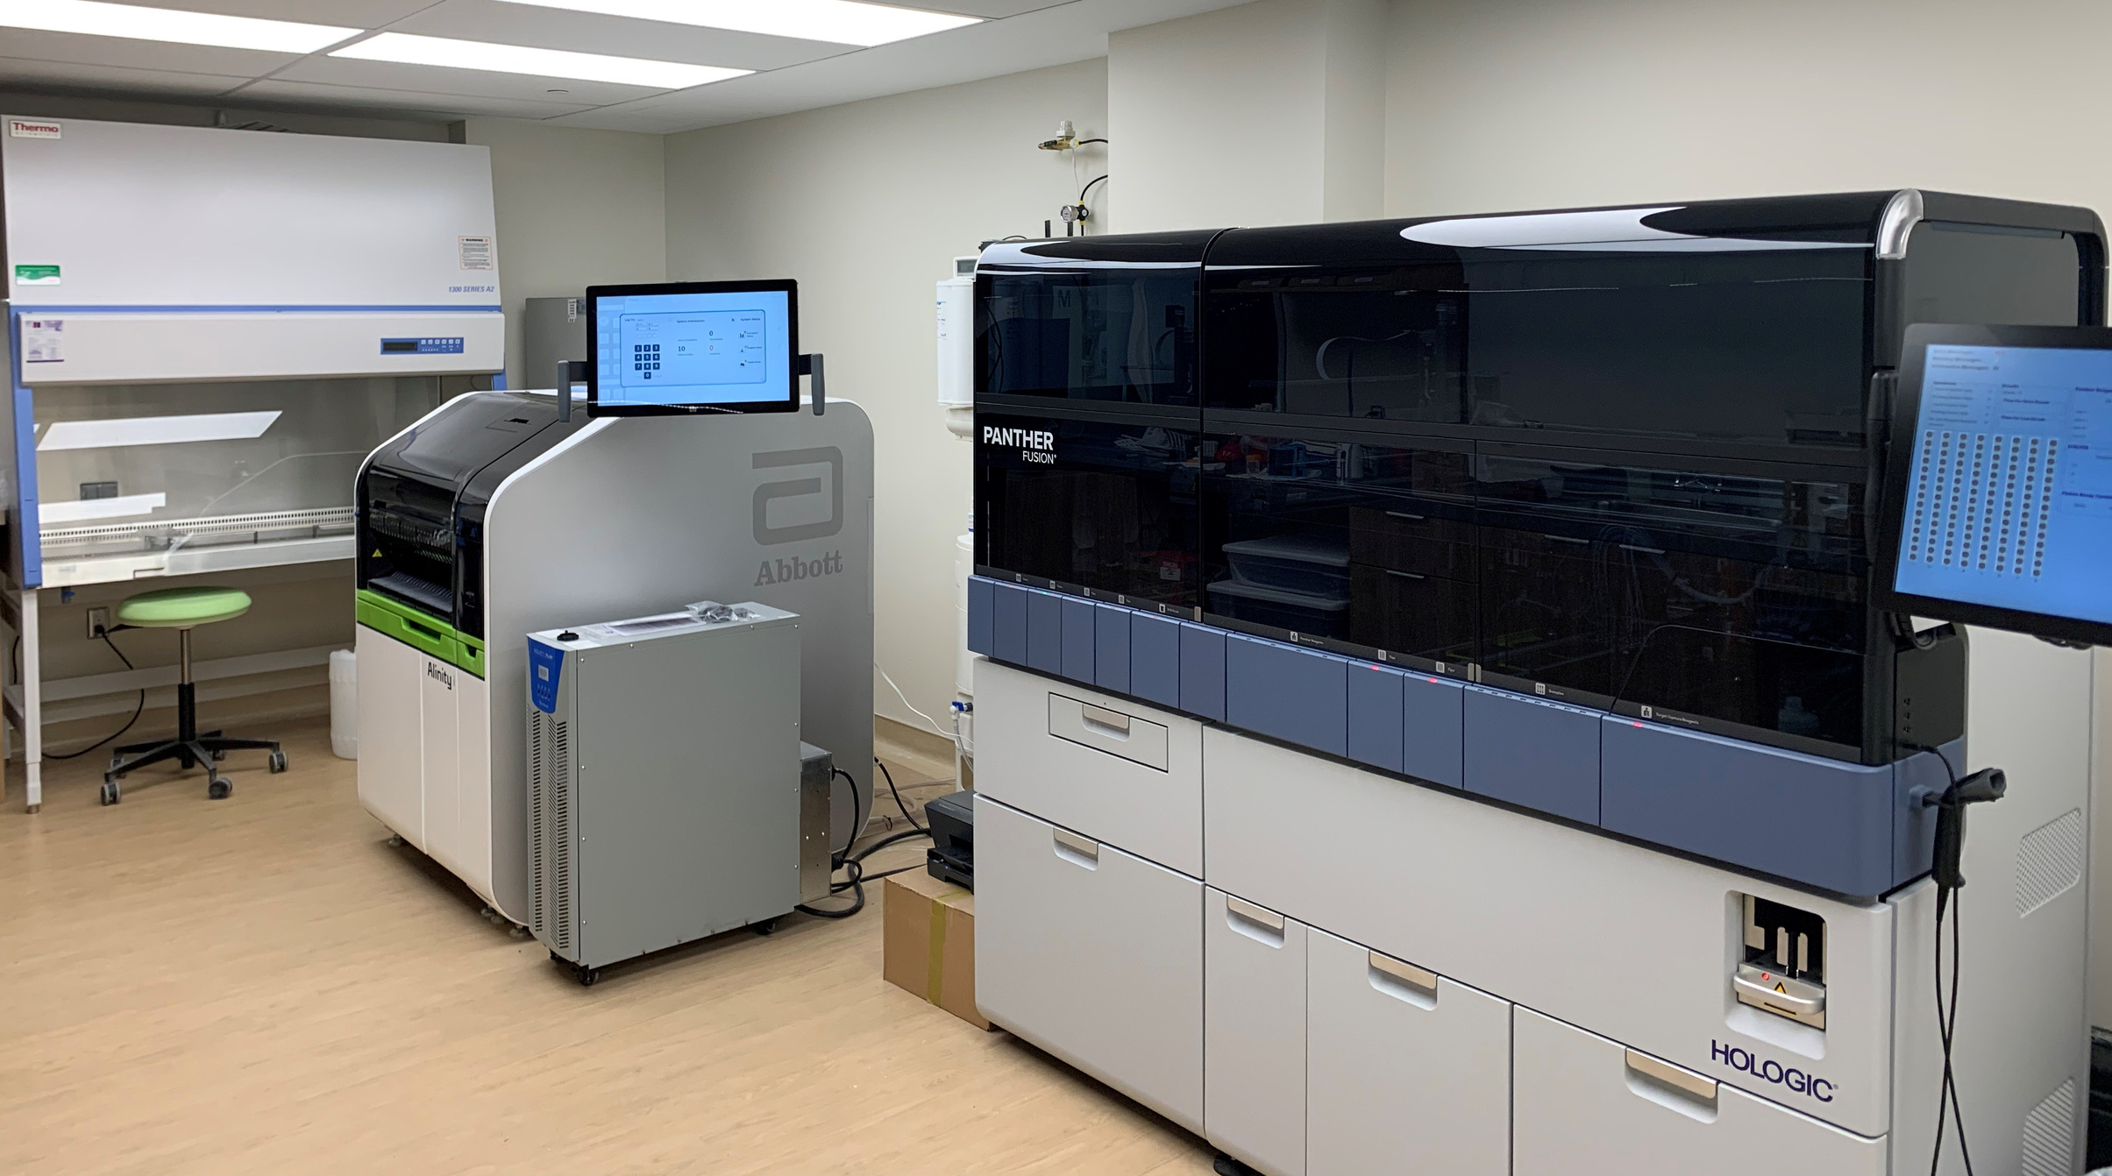
Patient Experience
March 2022 to January 2024
 | Score (out of 5) 599 surveys out of 28,939 sent Response rate 2.1% | % Negative reviews 😠(1/5) 🙁(2/5) | % Neutral reviews 😐(3/5)
Overall Experience | 4.81 / 5 | 2.2% | 1.5%
Efficiency | 4.78 / 5 | 2.5% | 2.2%
Welcoming | 4.78 / 5 | 2.7% | 1.7%
Recommend to a friend | 4.88 / 5 | 1.5% | 0.8%
“I feel completely safe understood and that I can speak freely about my medical needs as a gay man. I have never felt that before in a medical facility.”
- Anonymous survey
10

Slide 12
Patient Experience
December 2023
 | Score (out of 5) 55 surveys out of 2,550 sent Response rate 2.2% | % Negative reviews 😠(1/5) 🙁(2/5) | % Neutral reviews 😐(3/5)
Overall Experience | 4.84 / 5 | 1.8% | 1.8%
Efficiency | 4.89 / 5 | 1.8% | 0%
Welcoming | 4.80 / 5 | 3.6% | 0%
Recommend to a friend | 4.90 / 5 | 1.8% | 0%
"Pienso que en verdad fue un ecxelente servicio, muy amables y me atendieron rapido"
I think it was truly excellent service, very kind, and they attended to me quickly.
- Anonymous survey
10

Slide 13


Patient Experience
March 2022 to August 2023
J’ai une excellente apprécions l’endroit et moderne et propre les toilettes sont futuriste et le personnel est professionnel c’est une merveilleuse addition pour la communauté gay
"I have an excellent appreciation for the place; it's modern and clean, the toilets are futuristic, and the staff is professional. It's a wonderful addition to the gay community."
11

Slide 14
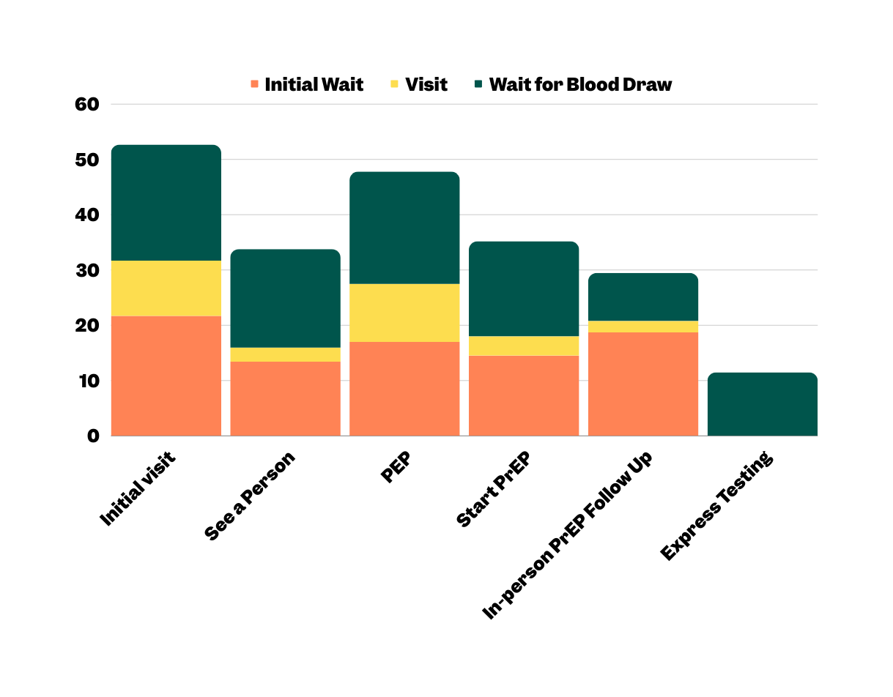
Outcome PREM -Visit Time
May - January 2024
Duration (minutes)
12

Slide 15
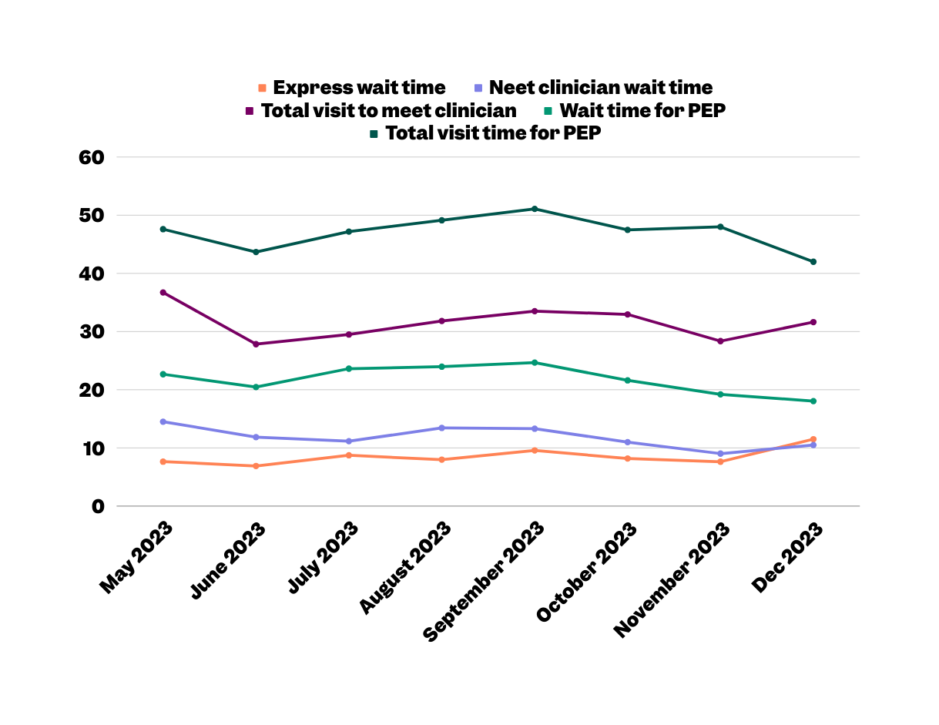
Outcome PREM -Visit Time
May - January 2024
Duration (minutes)
12

Slide 16
Improving the Health of Our Community
152,764Test results
26,493Treatment
13

Slide 17
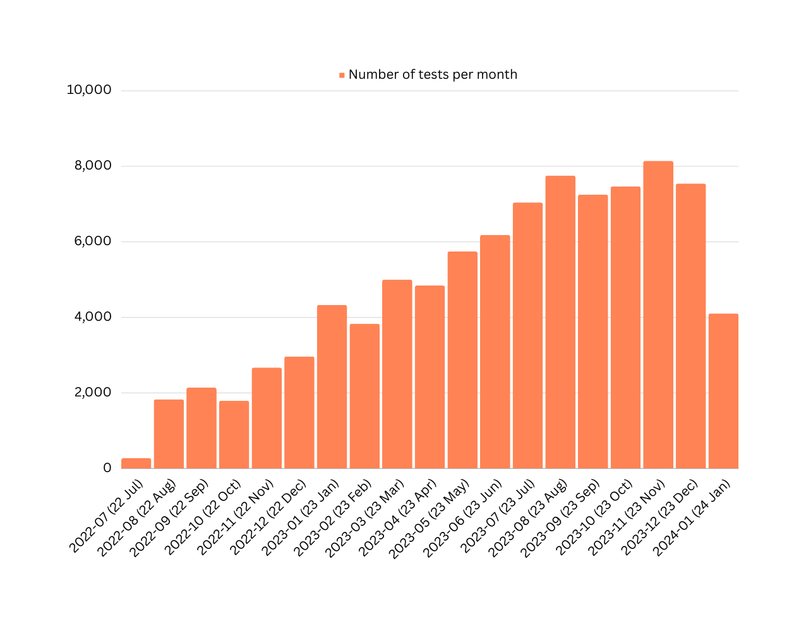
STBBI Testing- Overall
Overall Numbers
14

Slide 18
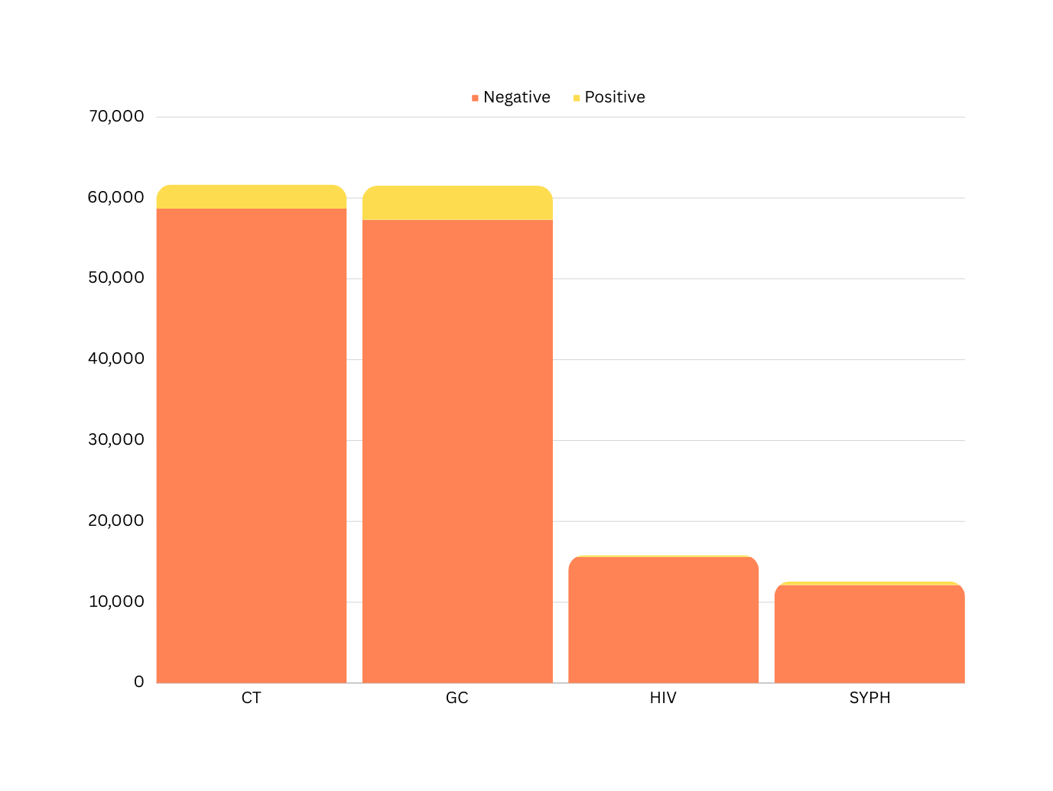
STBBI Testing
2980
4210
217
427
15

Slide 19
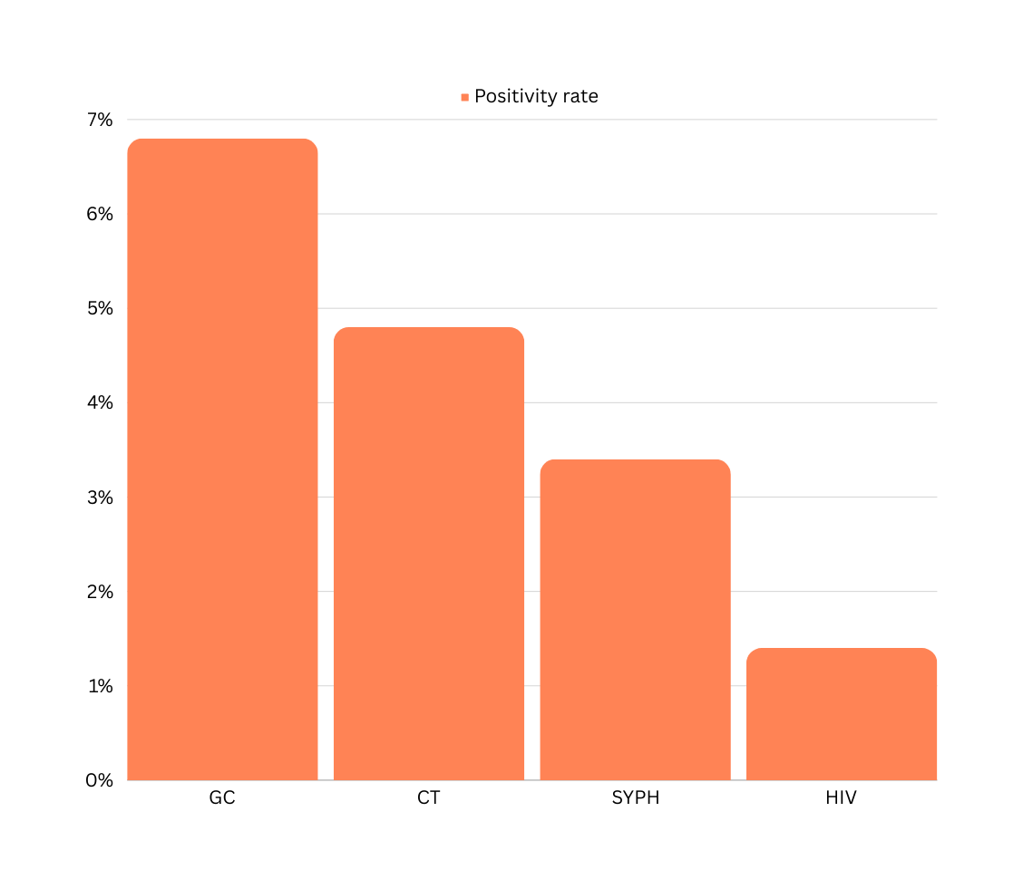
Positivity Rate
July 2022-January 2024
6.8%
4.8%
3.4%
1.4%
16

Slide 20
December 2023
Per Test Cost
 | Cost / Test | Test Volumes | Labour cost / Test | July Total Cost / Test
HIV Ag/Ab Combo Assay | $1.85 | 1367 | $ 2.81 | $ 4.63
Syphilis TP Assay | $ 1.34 | 1090 | $ 2.81 | $ 4.12
Aptima Combo 2 | $9.50 | 5066 | $ 2.81 | $ 12.28
HIV-1 QuantDx | $25.00 | 21 | $ 2.81 | $ 27.78
18

Slide 21
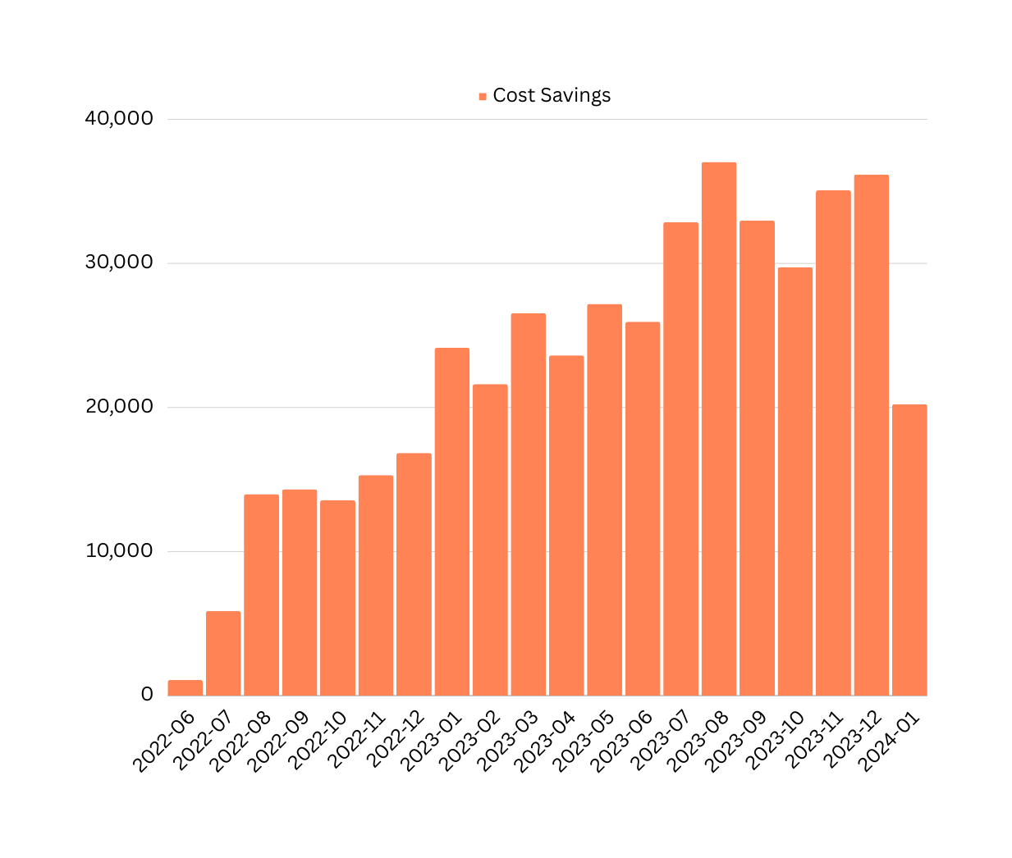
Monthly Cost Savings from Express Testing
Total cumulative savings to-date
$454,133
19

Slide 22
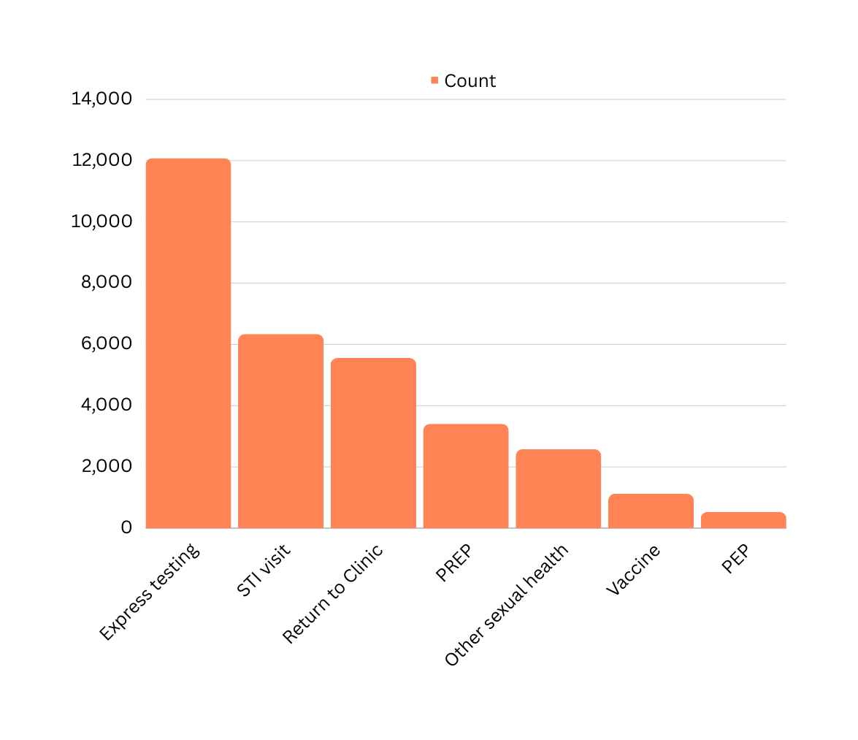
Reasons for Visit
July 2022 - January 2024
What individuals indicate on the kiosk as the reason for their visit
20

Slide 23
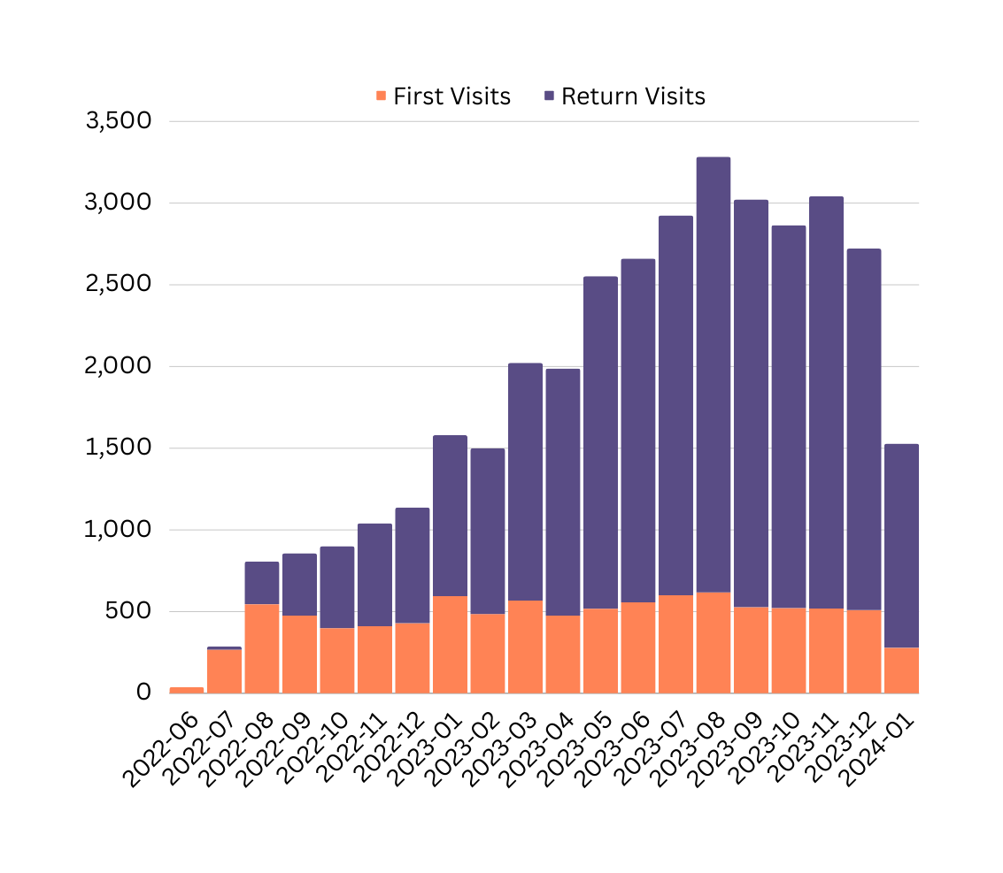
First vs Return
July 2022 - January 2024
21

Slide 24

Unmet STBBI Needs
July 2022 - January 2024
1609 uninsured or precariously insured individuals accessing care at HQ (no OHIP or IFH)
1419 STBBIs diagnosed and treated amongst uninsured individuals
1122 gonorrhea or chlamydia
450 syphilis
1868 treatments given to 898 service users (includes empiric treatments)
22

Slide 25
Unmet HIV Needs
July 2022-January 2024
273 individuals with no OHIP, living with HIV receiving their HIV care at HQ
23

Slide 26

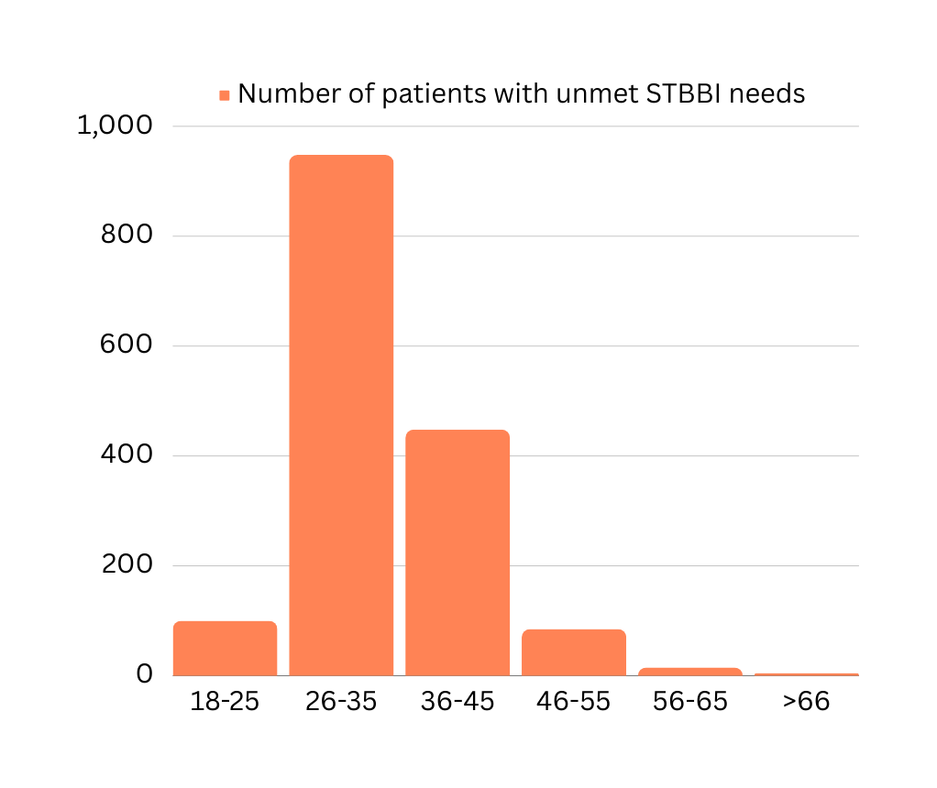
Unmet STBBI Needs
Age
Number of individuals
24

Slide 27
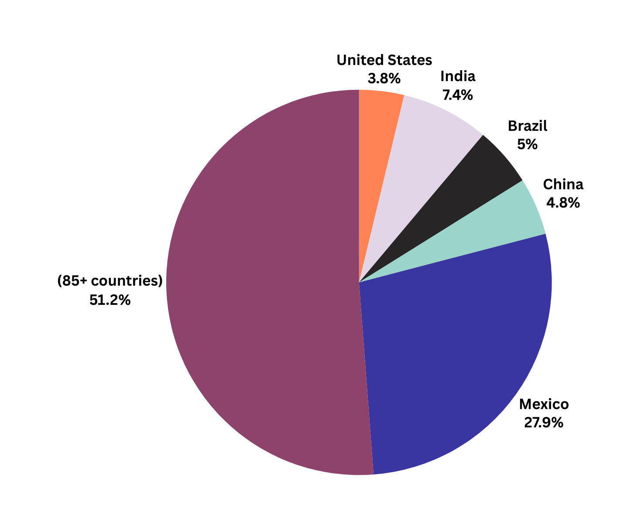

Unmet STBBI Needs
Country of Origin
Other countries of origin (individuals): Ukraine, Saudi Arabia, Peru, Barbados, Thailand, Cyprus, Hungary, Venezuela, Germany, South Korea, Spain, France, Uganda, Nigeria, Guyana, Ghana, Panama, Australia, Jamaica, Pakistan
25

Slide 28
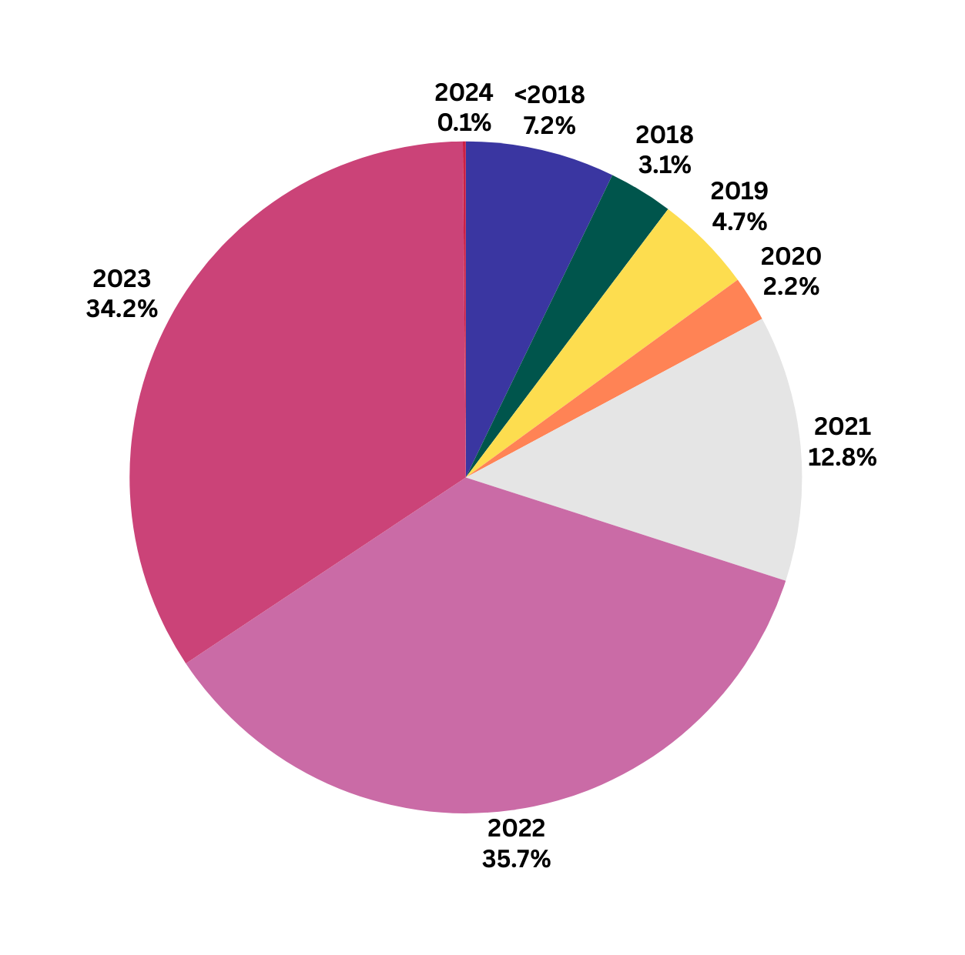
Unmet STBBI Needs
Year of Arrival in Canada
26

